Slide 1

r/place 2023
Sam Kaseff, Sean King

Slide 2
Overview of Our Method for Simplifying the Data
Step by Step:
An empty list data frames is created to store pieces of processed data from each file.
Looping through Files:
The code loops through file names from "2023_place_canvas_history-000000000000.csv" to "2023_place_canvas_history-000000000052.csv".
For each file, the code constructs the file's name based on its number in the sequence and reads the file into a DataFrame
Sampling:
From each file's data, the code randomly selects a small fraction (0.1%) of the total rows.
Processing Coordinates:
The 'coordinate' column, which contains the pixel placement coordinates, is processed by separating the numbers into two new columns, 'coordinate_x' and 'coordinate_y', representing the X and Y coordinates where the pixel was placed.

Slide 3
Overview (cont.)
Extracting Color Information:
The color of each pixel is stored in a hexadecimal format (like #FFFFFF) in the 'pixel_color' column. The code extracts the red (R), green (G), and blue (B) components from this hexadecimal format and converts them into integers, creating three new columns ('R', 'G', 'B') in the DataFrame.
Timestamp Processing:
The 'timestamp' column is converted to a DateTime format to make it easier to work with and any timezone information is removed to avoid confusion between different time zones. The code calculates the number of days between each timestamp and the start_date defined earlier, and stores this in a new 'Day' column. This shows on which day each action occurred relative to the start date.
Combining Data:
After processing each file, the resulting data frame is added to the data frames list and they are then concatenated into a final data frame that is a fraction (.001) of the entire dataset while also representing it accurately.

Slide 4
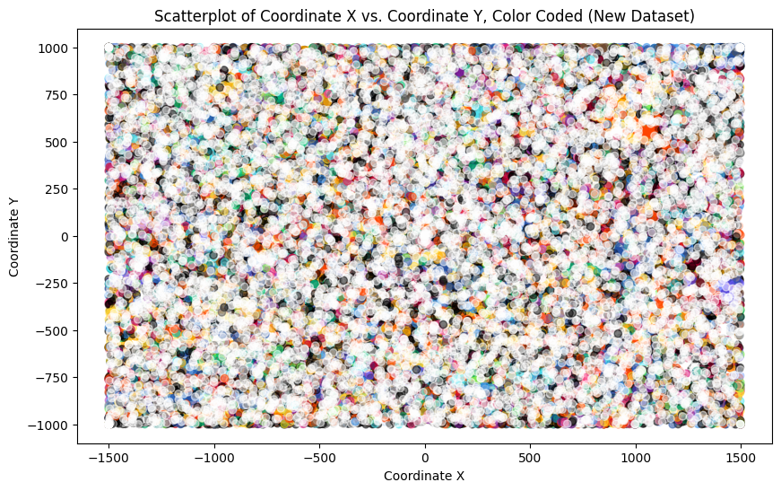
Combined Dataframe Visualization (R/place Simplified)
A simplified version of Rplace.
Represents a fraction of the data in R/place.
Interestingly, appears like most common color is white, but after some analysis, the most common color is actually #000000, which is black with 28,706 instances. This corresponds in the full dataset to be ~29 million black pixels.

Slide 5
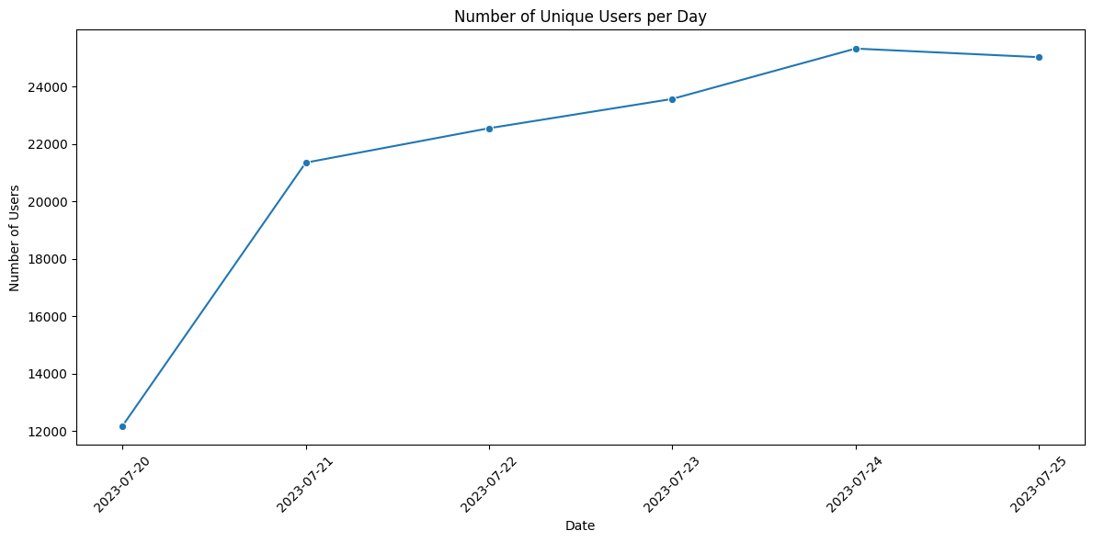
Unique Users Each Day
This line graph shows the amount of unique users each day in R/place.
Interestingly, the amount of unique users drops slightly on the last day, suggesting some people stopped putting pixels, perhaps caused by fatigue or a lack of caring.

Slide 6
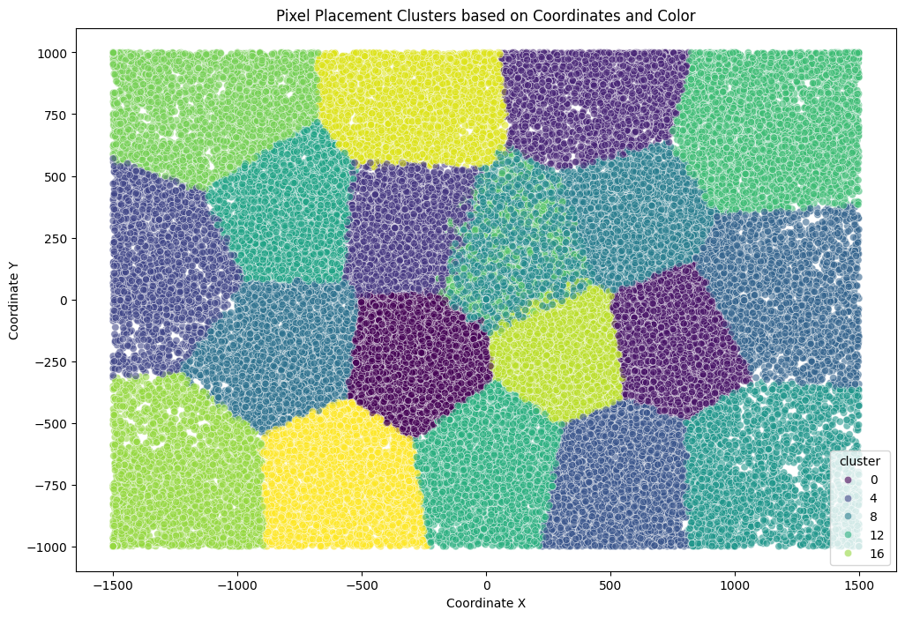
K-Means Clustered Data
A cluster analysis with 20 clusters based on the colors and coordinates of the pixels put into R/place.
The geometry that it resulted in is fascinating, the clear borders between the different areas suggest that users are filling in predefined areas within R/place.
This could suggest that bots are being used to fill in predefined areas that could be the output of some program with pixels.
Denser areas of the clusters indicate that more pixels are being placed in specific areas, perhaps by bots.
The area in the center, that contains 2 different clusters, could be caused by more people wanting to add pixels to the center, outweighing the contributions made by bots with more dissimilar pixels.

Slide 7
Conclusion
While there appears to be evidence of bots, real people also are inputting pixels into R/place at a high rate.
Contrary to our assumption, interest in R/place appears to wane in the last day. This could indicate that the real people placing pixels are losing interest.
The center of the image appears to be the most popular for real players to place pixels due to the dissimilar clusters, while the edges of the image appear to be more popular for bots.

Slide 8
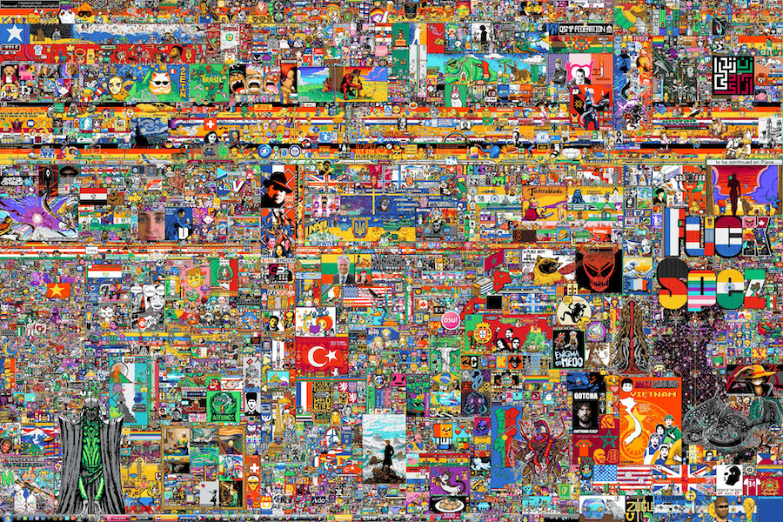
Thank You!

